Slide 1

Covid-19 Data Analysis
From the New York Times Covid-19 Dataset
Kenneth Bentley
Data Analytics-2

Slide 2
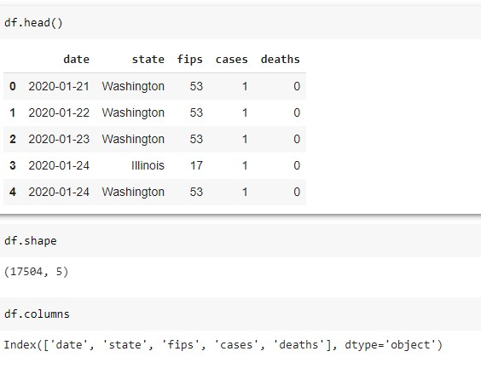
US Data Information
Data was taken from the NY Times Coronavirus database of Covid-19 Data in the United States
https://github.com/nytimes/covid-19-data/blob/master/us-counties.csv

Slide 3
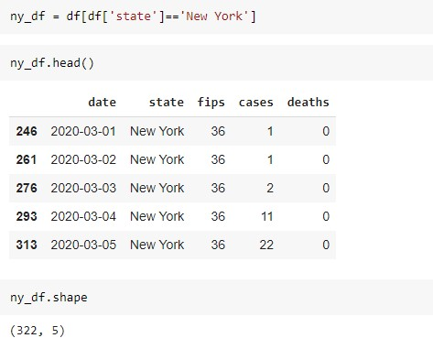
Data for New York State

Slide 4
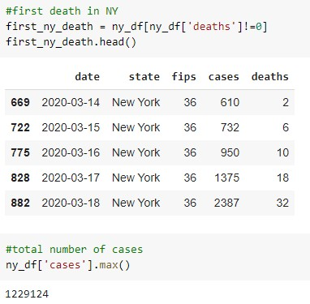
Exploratory Data Analysis
When was the first death in New York?
What are the total number of cases?

Slide 5
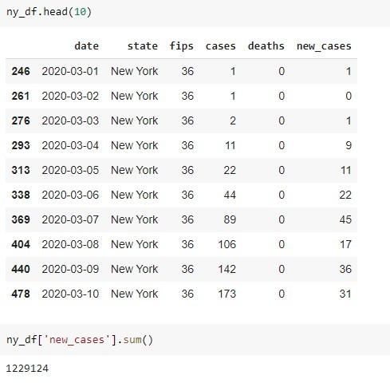
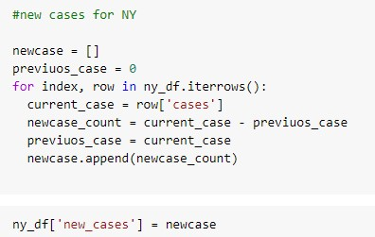
EDA Continued
Code for adding New Case Count to Data Frame
Data Frame with added column: “New Cases”

Slide 6
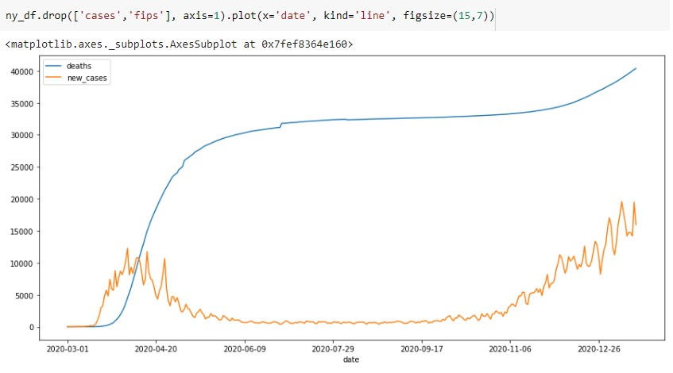
New York New Cases and Deaths

Slide 7
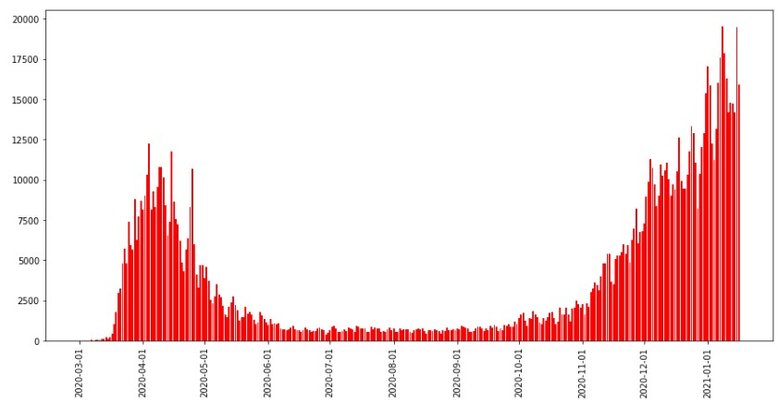
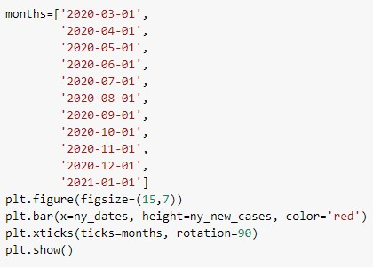
New Cases in New York

Slide 8
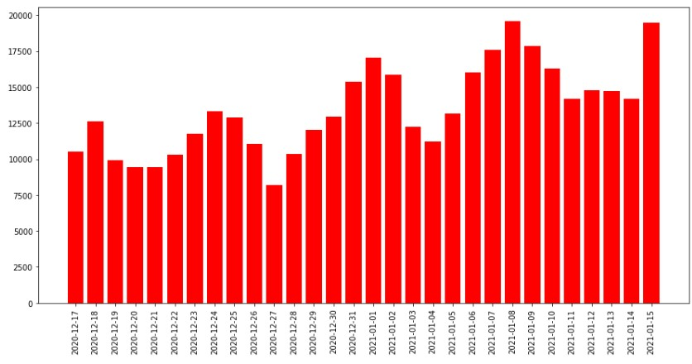
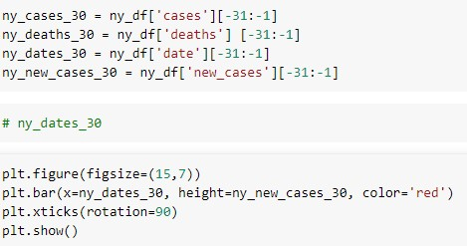
New York Cases: Past 30 Days

Slide 9

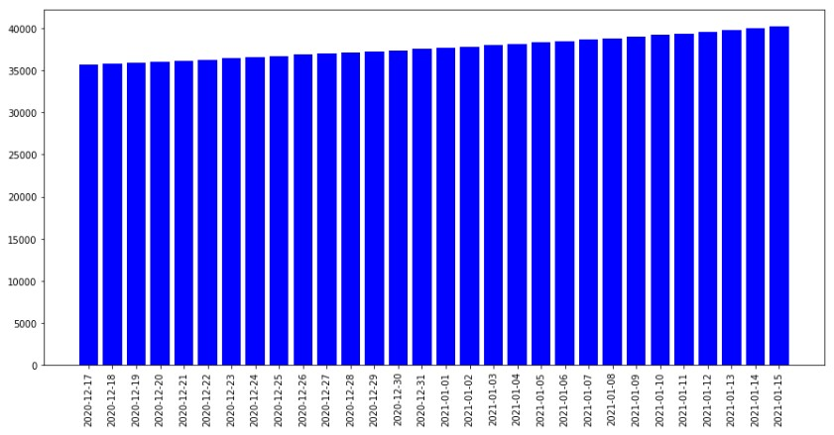
New York Deaths: Past 30 Days

Slide 10
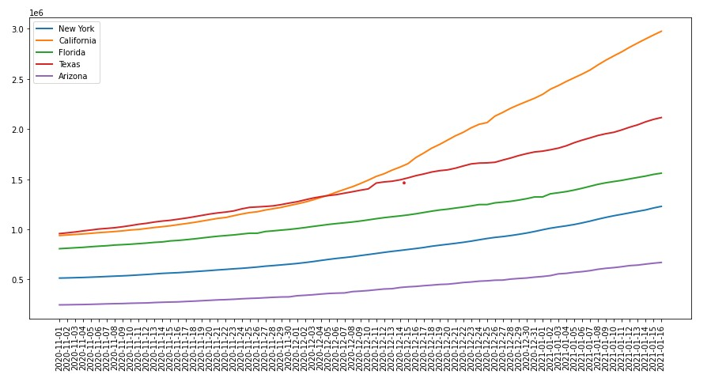
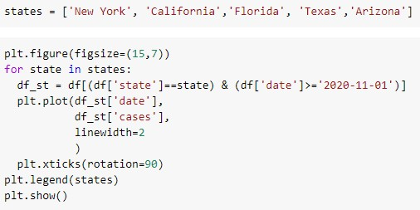
Comparing Covid-19 Data of New York, California, Florida, Texas and Arizona

Slide 11
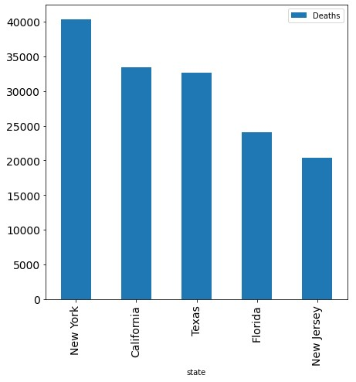
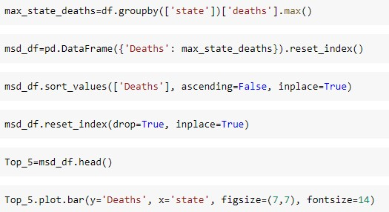
Which States Have the Highest Number of Deaths?

Slide 12
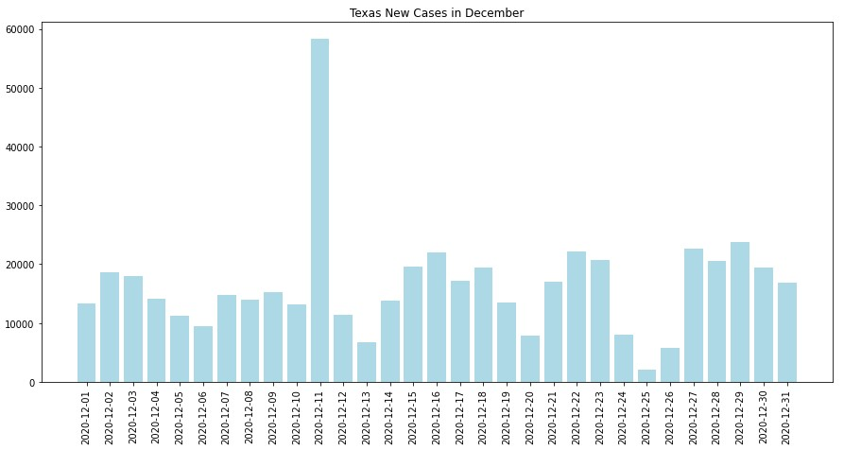
How Many New Texas Cases in December?

Slide 13
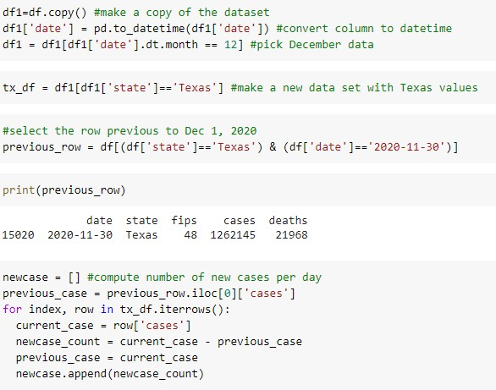
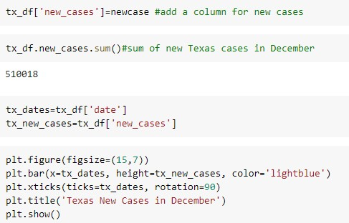
New Texas Cases in December

Slide 14
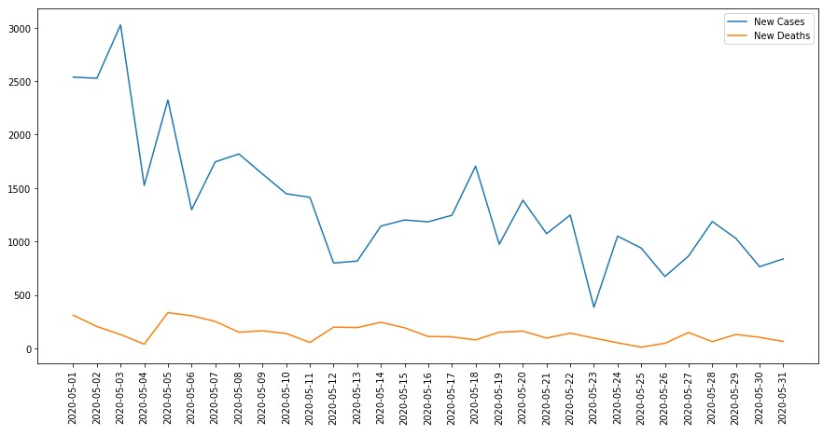
Comparison of New Jersey New Cases to Deaths in May

Slide 15
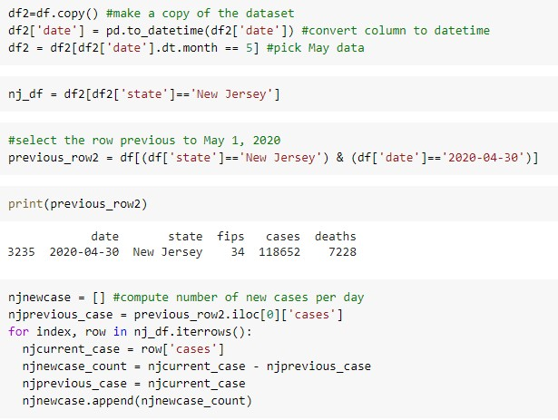
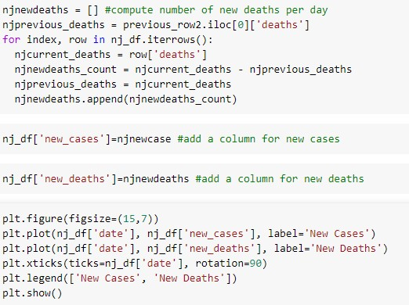
NJ New Cases to new Deaths in May

Slide 16
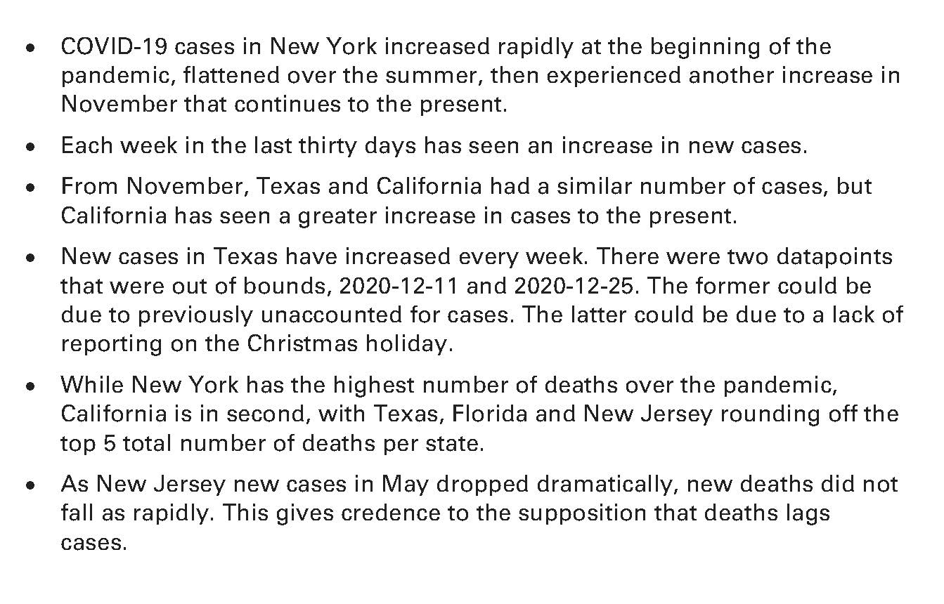
CONCLUSIONS

